Slide 1
Azure Data Factory
Data Transformation

Slide 2
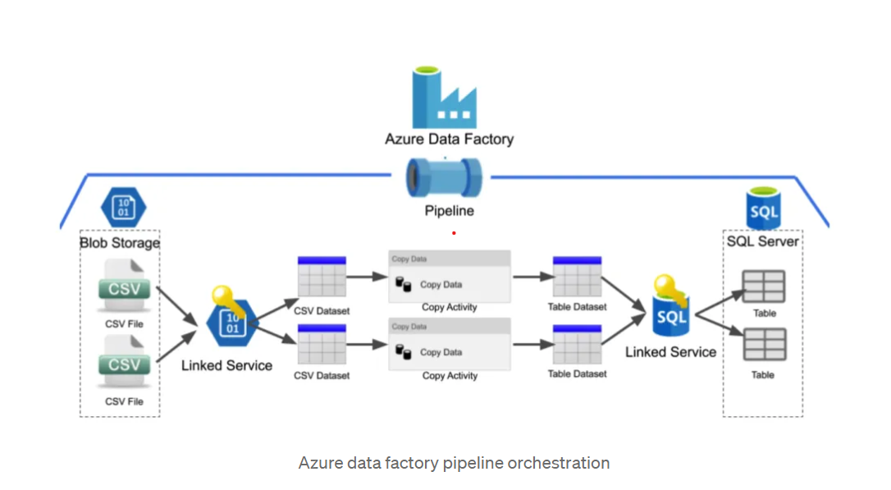
Data Factory
Microsoft’s Azure Data Factory (ADF) is a cloud-based data integration service. The platform provides users with the ability to construct, schedule, and manage data pipelines that transfer and transform data between different sources and destinations.
A key component of any data integration process is data transformation, which involves converting data from its original format into a format the target system can understand. You can manipulate data during pipeline execution by using ADF data transformation activities.

Slide 3
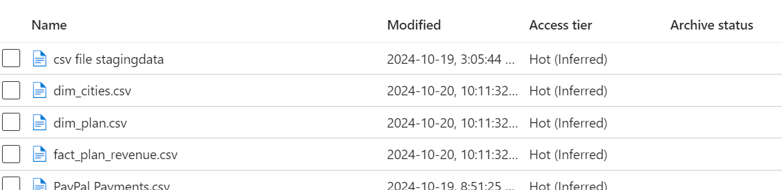
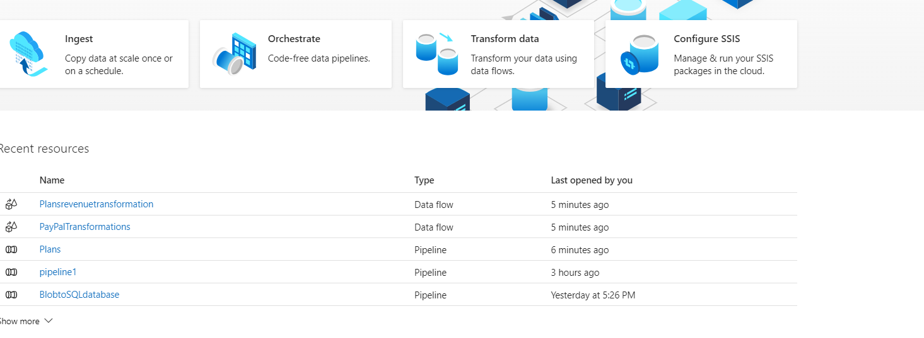
In this project we are copying data from BLOB storage to SQL Database.
SQL Server, Data Factory, and SQL databases are already provisioned
Now, we will select open Azure Data Factory Studio where we can build pipelines.
BLOB Storage
Data Factory

Slide 4
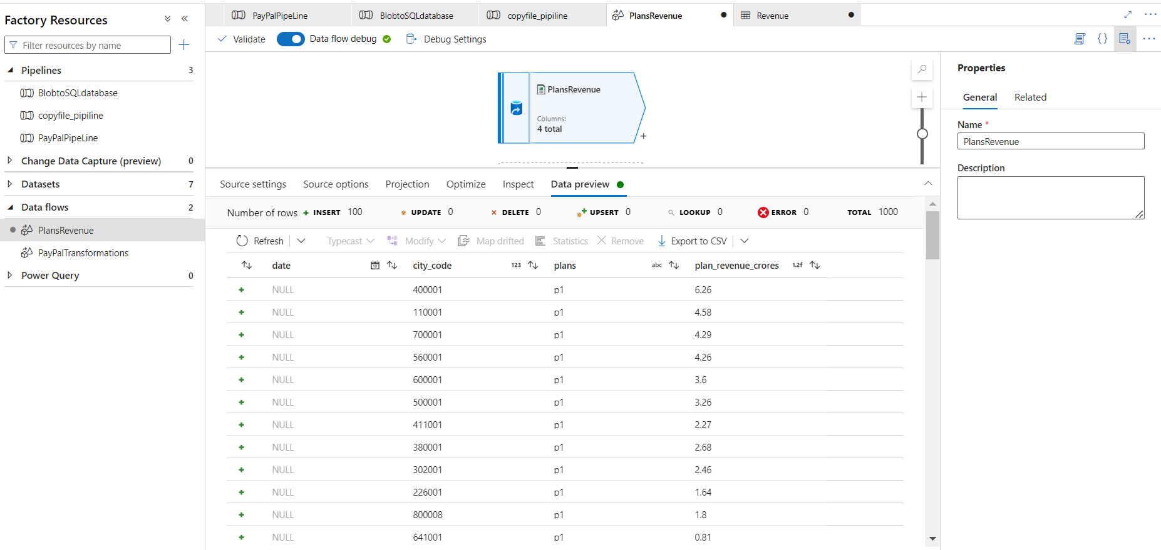
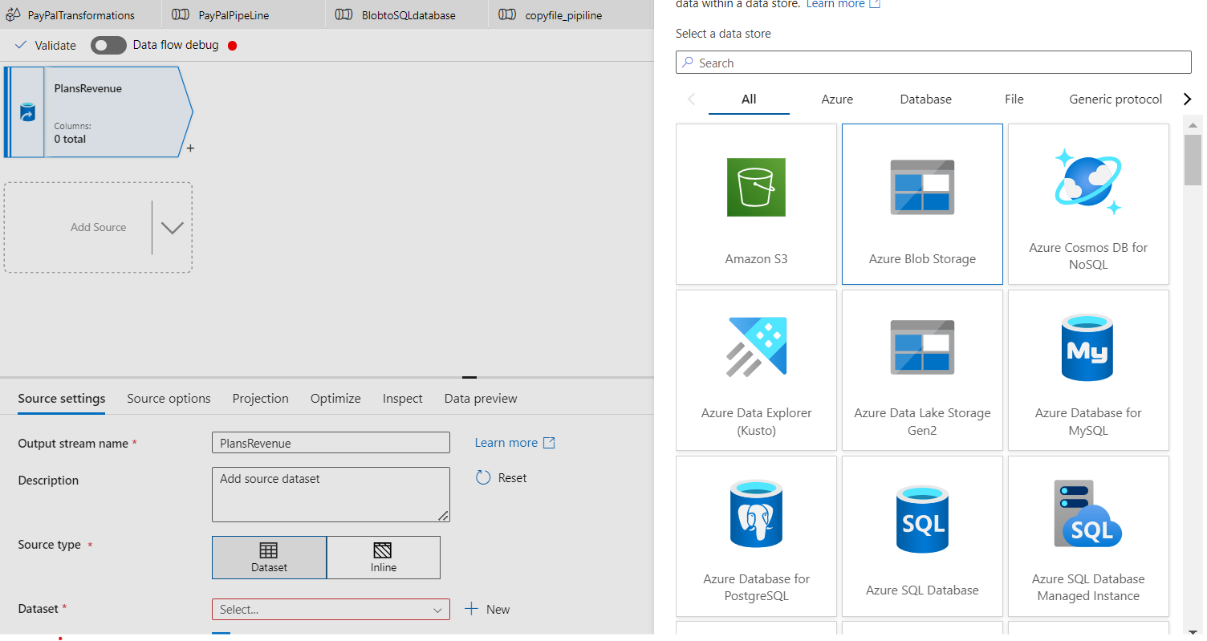
Data Flow Creation
First, we create Data Flow
To create Data Flow, we need Source Data
There are 2 types of Data Sources
Dataset – Getting data within Azure or within Source
Inline – Feeding data from local storage or web
Goto our BLOB Storage and select the data Format (csv,JSON,Excel,XML,etc)
we need to select the right table called ”fact_plan_revenue”
Go to Data Preview and preview the data

Slide 5
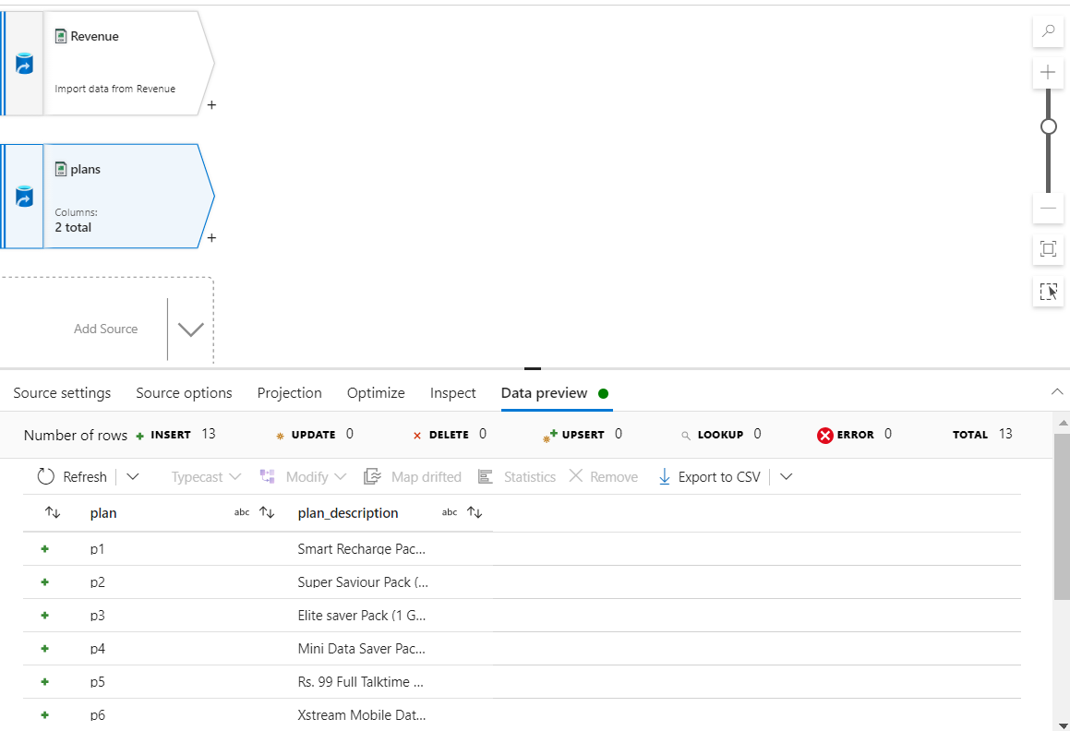
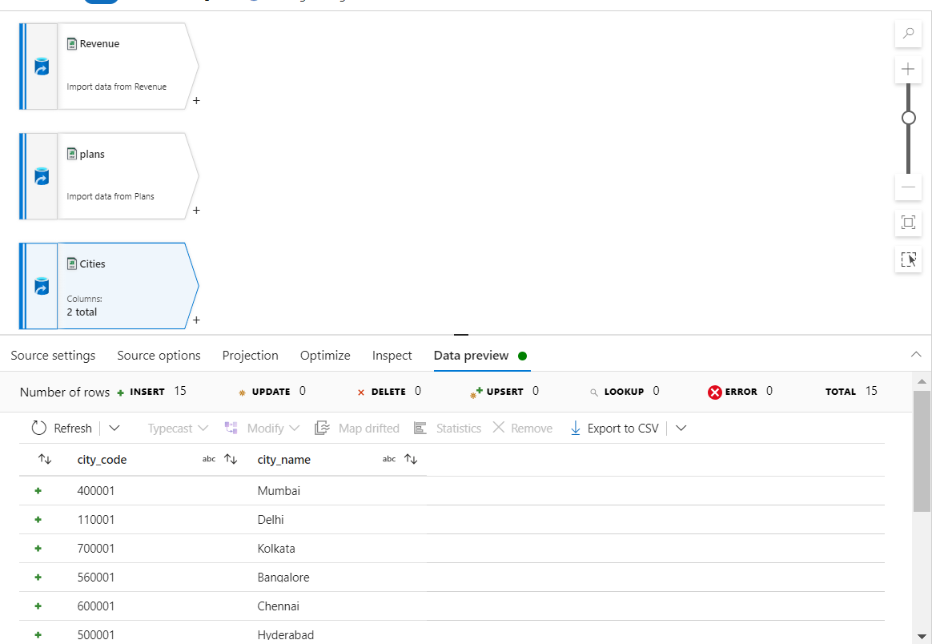
Add Dimension tables
1. Add dim_plan.csv to the source and preview the data and validate the data at every step
2. Add dim_cities.csv to the source and preview the data and validate the data at every step

Slide 6
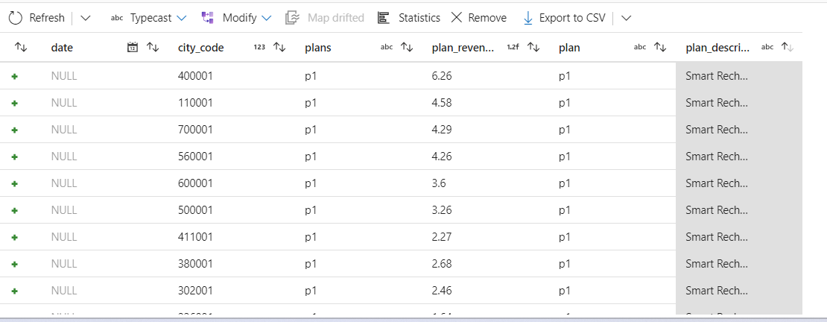
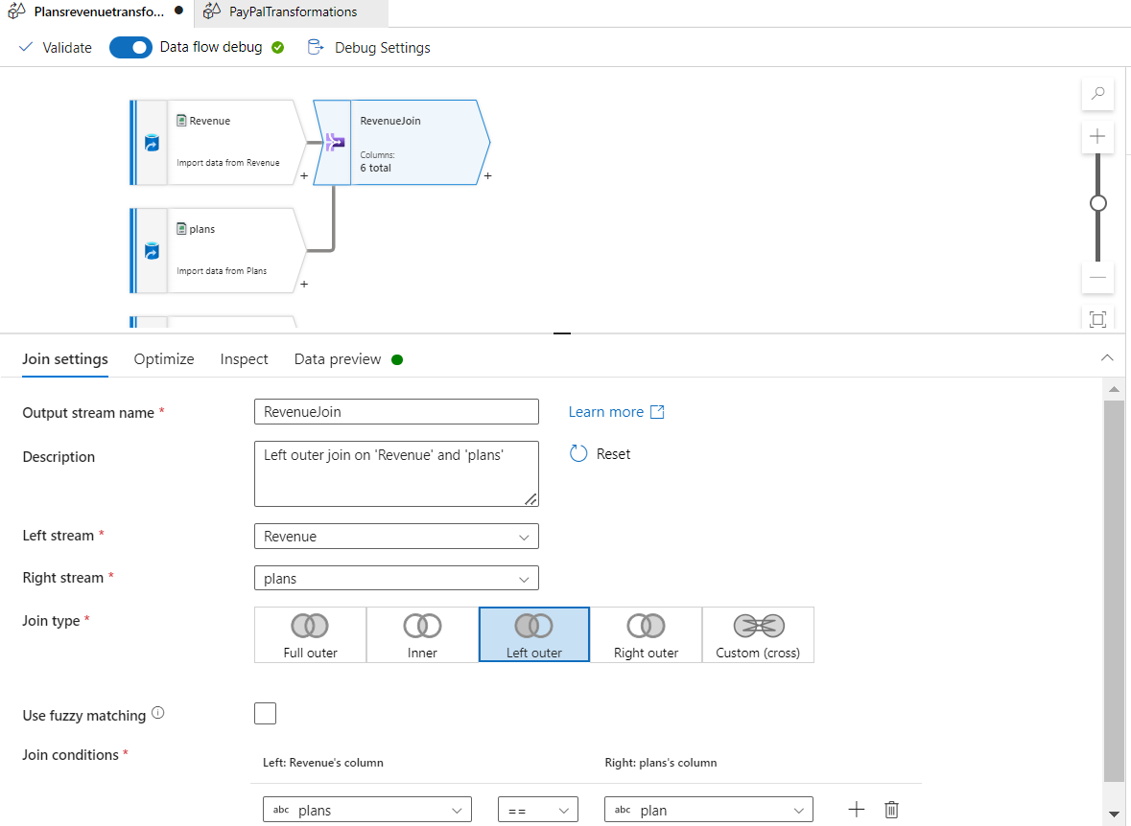
Data Transformation
Perform Left Outer Join between fact table (fact_plan_revenue) and dimension tables (dim_plan,dim_cities)
Preview the data and validate the data

Slide 7
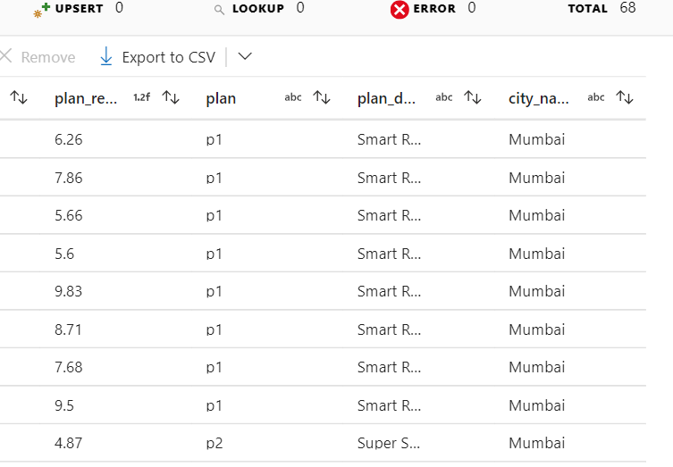
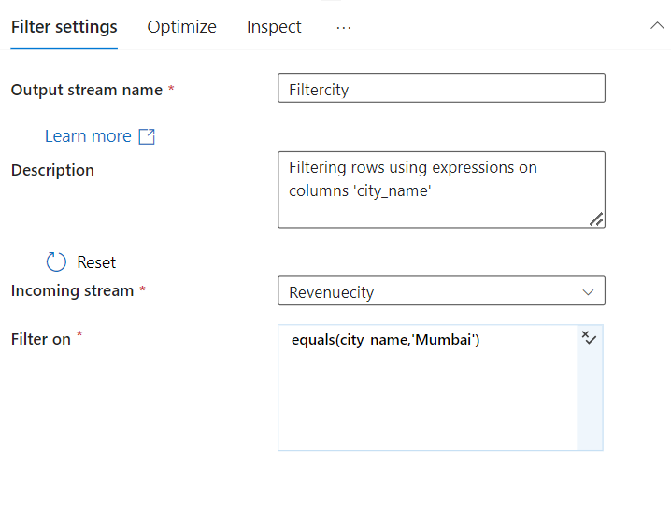
Filter Data:
Here we want data from city Mumbai to Analyze

Slide 8
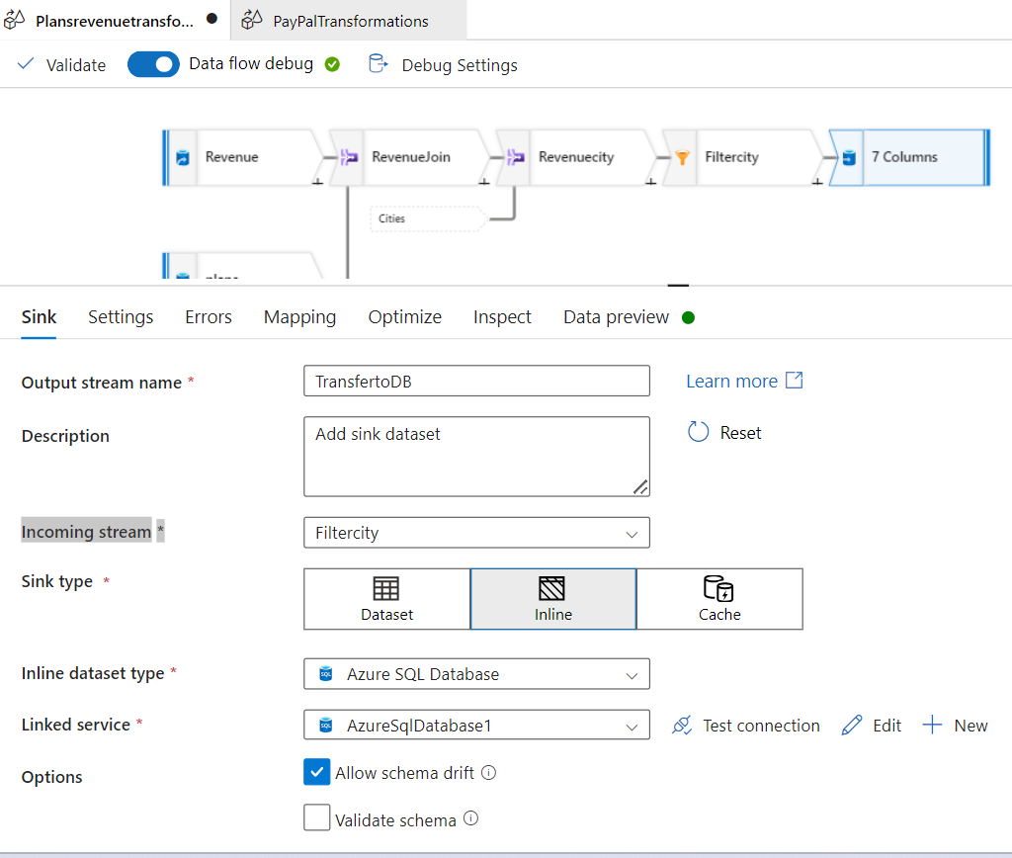
Add in a Sink
Test the connection
Preview the data

Slide 9
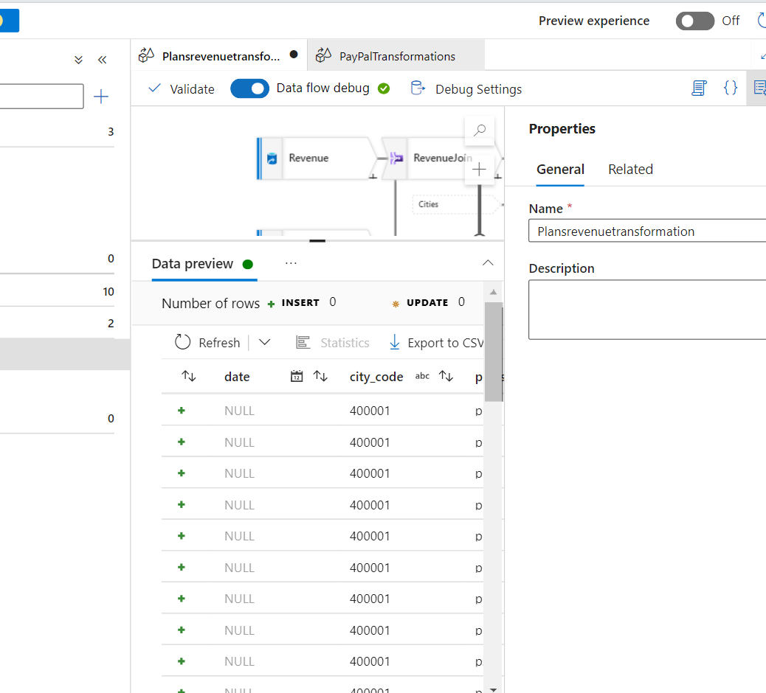
Validate the data
To check for any Issues

Slide 10
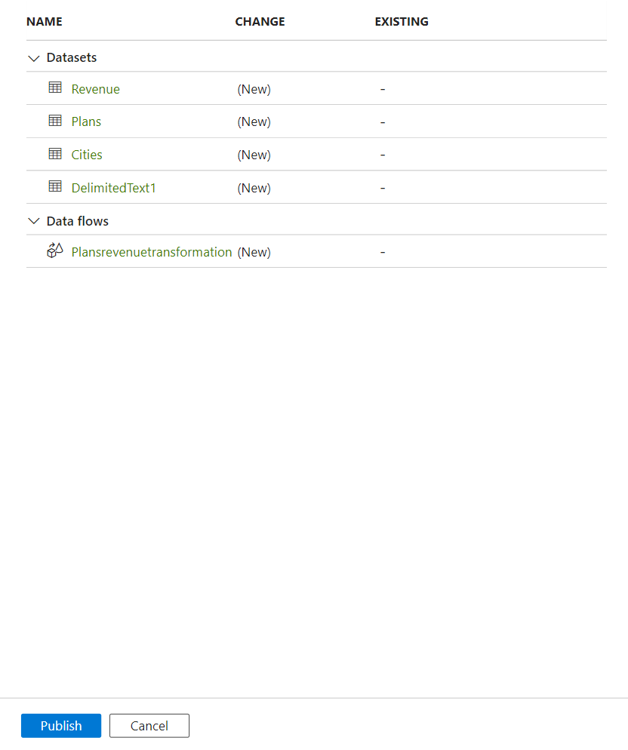
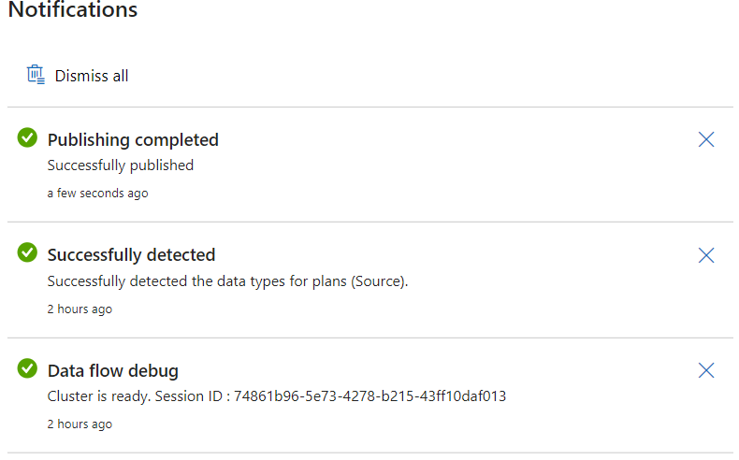
Publish All

Slide 11
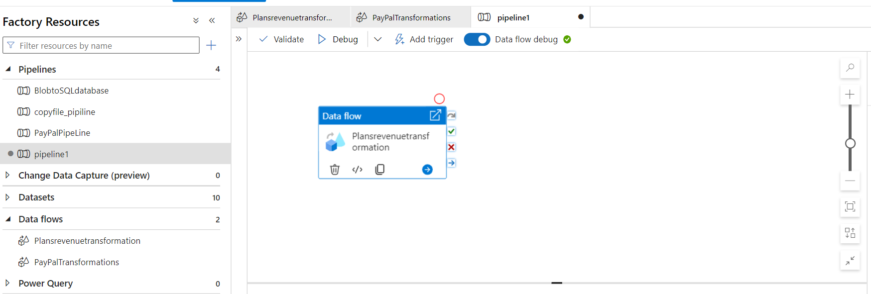
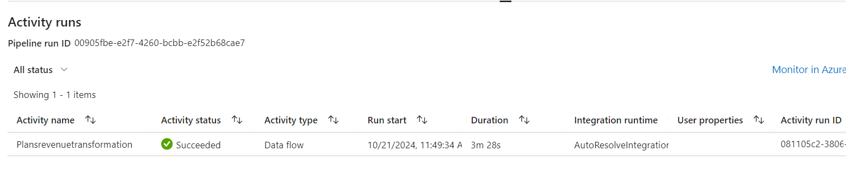
Pipeline
Add the newly created “PlansRevenuetransformation” Dataflow to pipeline
After publishing, the pipeline can be triggered by selecting the trigger now option
This will take a few mins to run until it says succeeded.

Slide 12
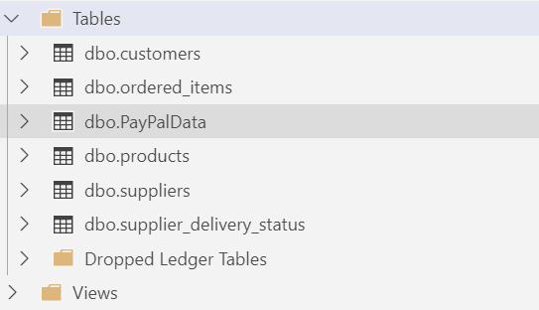
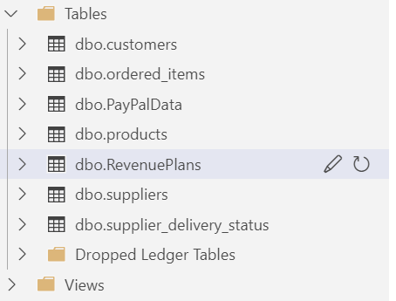
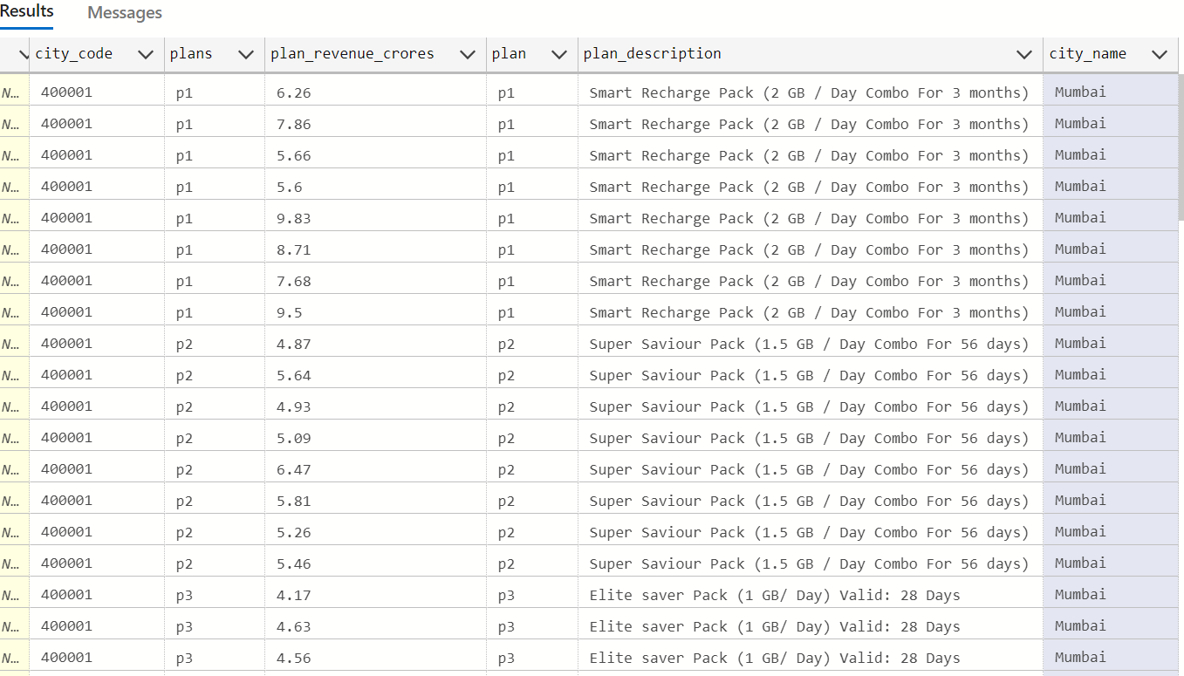
Before After Migration
SQL Database
After we verify that our pipeline run is successful, we can go back to our Query editor and run a SQL query to see if the data was migrated.
Run the SQl query and validate the data

